Slide 1

The NYC Airbnb Story
A Look at Listings, Prices, and Popularity
Uncovering insights from the NYC Airbnb dataset (2019)Presented by Farhan & Zainab– Data Storyteller

Slide 2
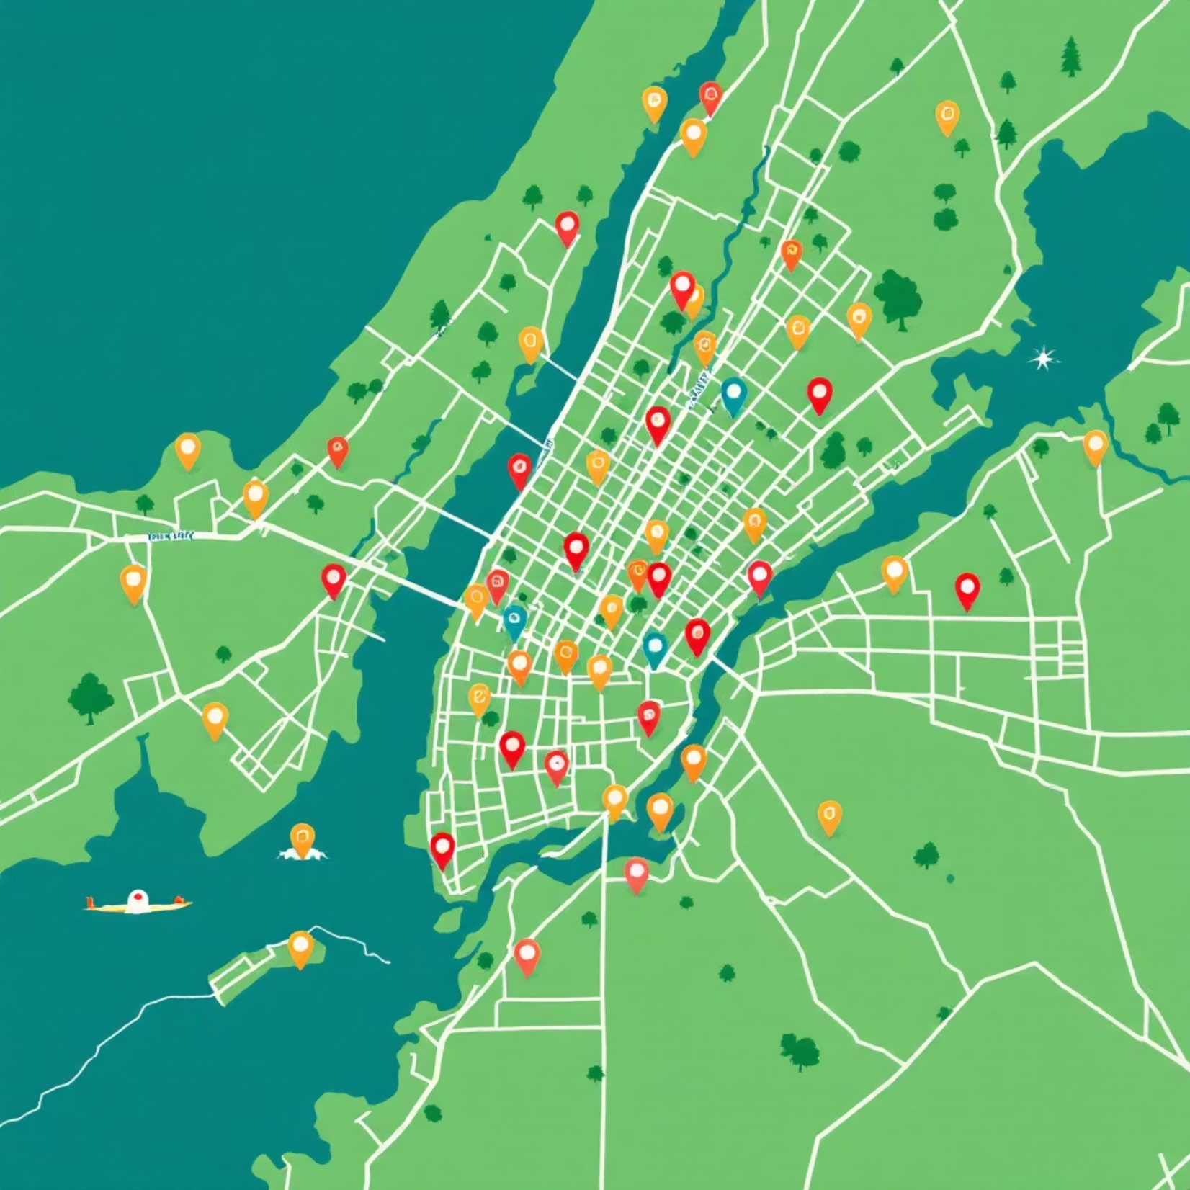
The City That Never Sleeps
New York City — the city that never sleeps, and neither does its Airbnb market. Behind every pin on the map lies a unique story waiting to be told.
Our dataset captures thousands of listings scattered across five distinct boroughs, each one representing a different flavor of the New York experience. From luxurious Manhattan penthouses to cozy Brooklyn brownstones, this is the landscape where travelers find their temporary homes.

Slide 3




Where the Story Unfolds
Every great story needs a setting. In the NYC Airbnb landscape, some neighborhoods take center stage while others wait in the wings.
Manhattan
Brooklyn
The undisputed star — where tourism thrives and listings flourish in the shadow of iconic landmarks.
The creative co-star — offering authentic neighborhood vibes and artistic energy across the East River.
Queens
Bronx & Staten Island
The affordable alternative — diverse communities providing genuine New York living at accessible prices.
The emerging players — quieter boroughs with untapped potential and authentic local character.

Slide 4



The Kinds of Places We Find
Every listing tells a story about the kind of stay guests desire. The variety is as diverse as the city itself.
52%
45%
3%
Entire Homes
Private Rooms
Shared Rooms
The stars of the show — full apartments where guests enjoy complete privacy and independence.
Cozy and budget-friendly — a bedroom to call your own while sharing common spaces with hosts.
The rare supporting character — minimal privacy but maximum affordability for adventurous travelers.

Slide 5

The Price of Experience
How much does a night in the city cost?
Prices swing dramatically across the five boroughs — from modest rooms to luxury penthouses. Manhattan commands premium rates, while Brooklyn and Queens balance comfort with cost.
$150
Average Nightly Rate
$212
Manhattan Premium
The range tells the real story — you can find listings from $10 to over $10,000 per night. Location, amenities, and room type all play their part in this pricing drama.

Slide 6




How Long Do Guests Stay?
Quick Visits
1-3 nights — the typical tourist trip. Fast-paced exploration of the city that never stops moving.
Week-Long Stays
4-7 nights — extended trips for deeper immersion in neighborhood culture and hidden gems.
Longer Journeys
8+ nights — less common but meaningful. This is Airbnb for explorers, not settlers.
In a city that moves fast, so do its guests. The data reveals a rhythm: arrive, explore, move on. Short stays dominate because New York demands intensity, not leisure.

Slide 7




Meet the Hosts
Behind every listing, there's a host — from casual sharers to savvy city entrepreneurs building hospitality empires.
1
Enterprise Hosts
2
Professional Hosts
3
Multi-Listing Hosts
4
Casual Hosts
The Majority
The Entrepreneurs
The Rare Few
Most hosts manage just one listing — everyday New Yorkers sharing their spare room or vacation apartment to supplement income.
A smaller group runs multiple properties, treating Airbnb as a business. They've mastered the art of hospitality at scale.
Enterprise hosts exist but they're uncommon — managing portfolios that span neighborhoods and boroughs.

Slide 8

Popularity: The Crowd's Favorites
Some listings steal the spotlight. Review counts reveal popularity — certain places accumulate hundreds of reviews, becoming neighborhood legends.
1
2
The Hidden Gem
Reviews Tell the Tale
The most visited listing? A private room in Jamaica, Queens — proof that charm, hospitality, and value can outweigh a prestigious Manhattan address.
High review counts signal consistent bookings and satisfied guests. These hosts have cracked the code of exceptional experiences.
3
Fresh Favorites
Monthly reviews per listing average around 1.4, showing steady activity across the platform throughout the year.

Slide 9

The Geography of Value
Location Still Matters
Proximity to hotspots like Times Square, Central Park, and the Brooklyn Bridge often drives up prices significantly.
But here's the twist: other boroughs prove that exceptional experiences exist beyond Manhattan's magnetic pull. Queens and Brooklyn offer authentic New York living at prices that won't empty your wallet.
The smartest travelers know that value isn't just about location — it's about the complete experience.

Slide 10




What the Data Reveals
The story of NYC Airbnb isn't just about numbers — it's about people finding homes, experiences, and memories in the world's most dynamic city.
For Travelers
For Hosts
For the Platform
Look beyond Manhattan. Authentic stays in Queens, Brooklyn, and the Bronx offer genuine New York experiences without the premium price tag.
Success isn't just about location. Charm, cleanliness, and hospitality can make any listing stand out, regardless of borough.
Diversity drives growth. The platform thrives because it offers everything from budget rooms to luxury penthouses across all five boroughs.
Thank you for joining this journey through the data. May your next New York adventure lead you to the perfect stay.

